Slide 1
Book Report
Colin Byrnes
10/30/2019

Slide 2

The book is a hybrid device - a storage, display, and distribution mechanism for literature, art, and information. Paired with an alphabet, it is the greatest invention of mankind: a dedicated object with the capacity for access and retrieval, without fail for hundreds of years - in version 1.0 - Steve Woodall

Slide 3

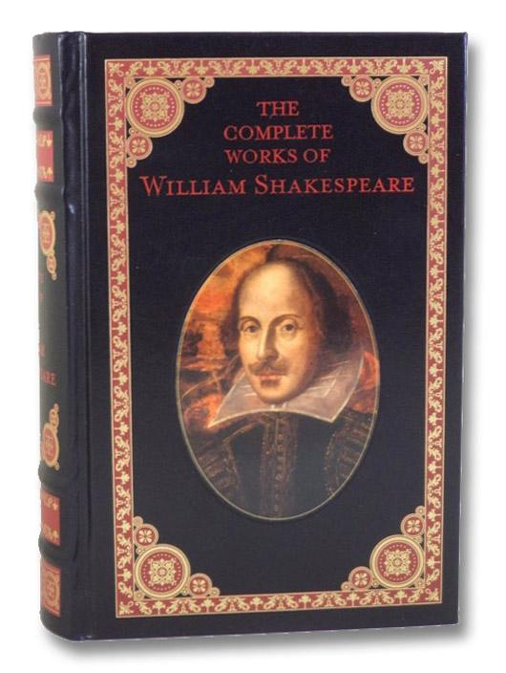

Books That fit Woodall’s Definition

Slide 4
The Complete Works of William Shakespeare
Collection of Plays
Remediated as a book to:
Increase distribution beyond the Globe theater
Preserve Shakespeare's plays
Today the Book form is:
Taught in schools
Easier to consult in academic study

Slide 5
Memories of Science - Dorothy A. Yule
Artist book
Verse & pop-up illustrations
Book form provides a unique mode of display

Slide 6
A Blank Notebook
a dedicated object with the capacity for access and retrieval.

Slide 7


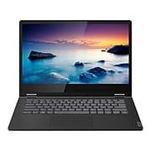
Counter-Examples to Woodall’s Definition

Slide 8
Woodall’s Definition excludes E-lit
No e-literature is a “dedicated object”
Kindle e-books match all use requirements
Storage, display, distribution, access and retrieval
- Agrippa hardly fulfills any of Woodall’s criteria, it only can be used for display.

Slide 9
Woodall’s Definition includes Laptops as books
A laptop fits Woodall’s definition of a book
Can access, store, display, and distribute
Literature
Art
Information
A Laptop is not a book - Woodall’s definition is too broad

Slide 10
As a network of embodied interactions, the book invites us all to delve into the spatial, temporal, visual, verbal and tactile experiences it brings together.
—Tatiani Rapatzikou
Second Definition

Slide 11
My Definition
A book is a portable collection of literature, art, and/or information for a reader to interact with, bound together for a unified purpose.

